Slide 1
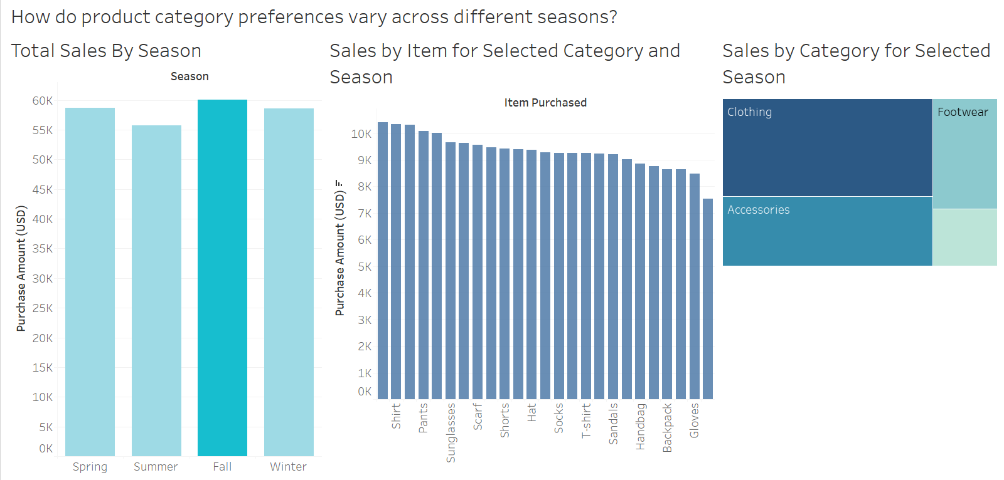
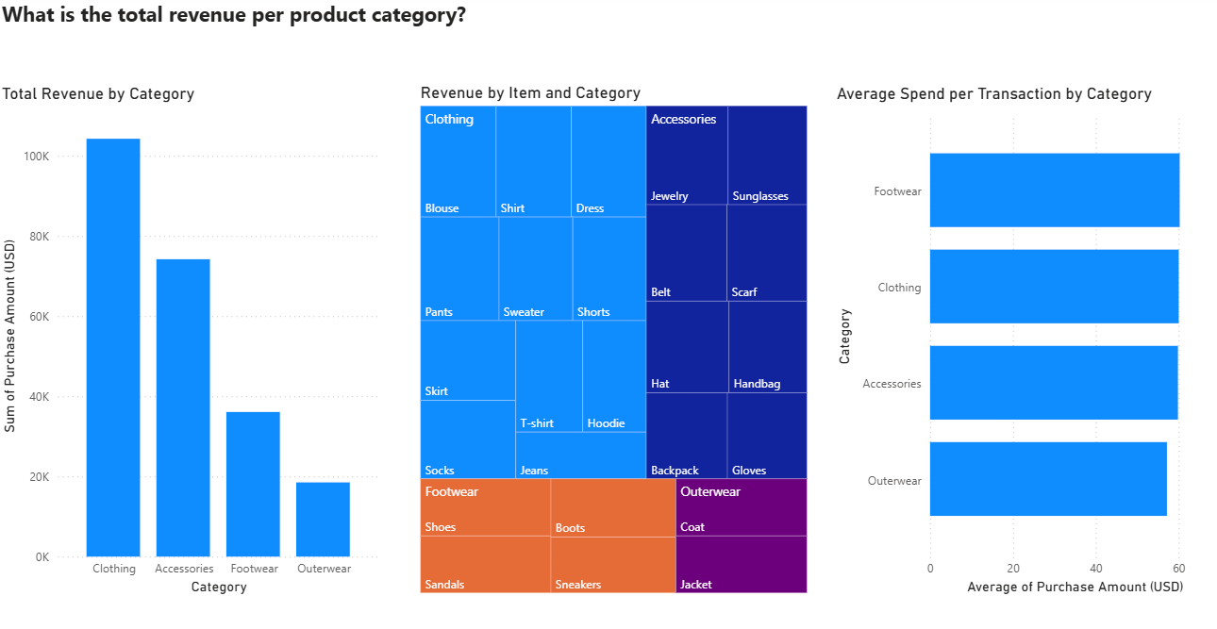

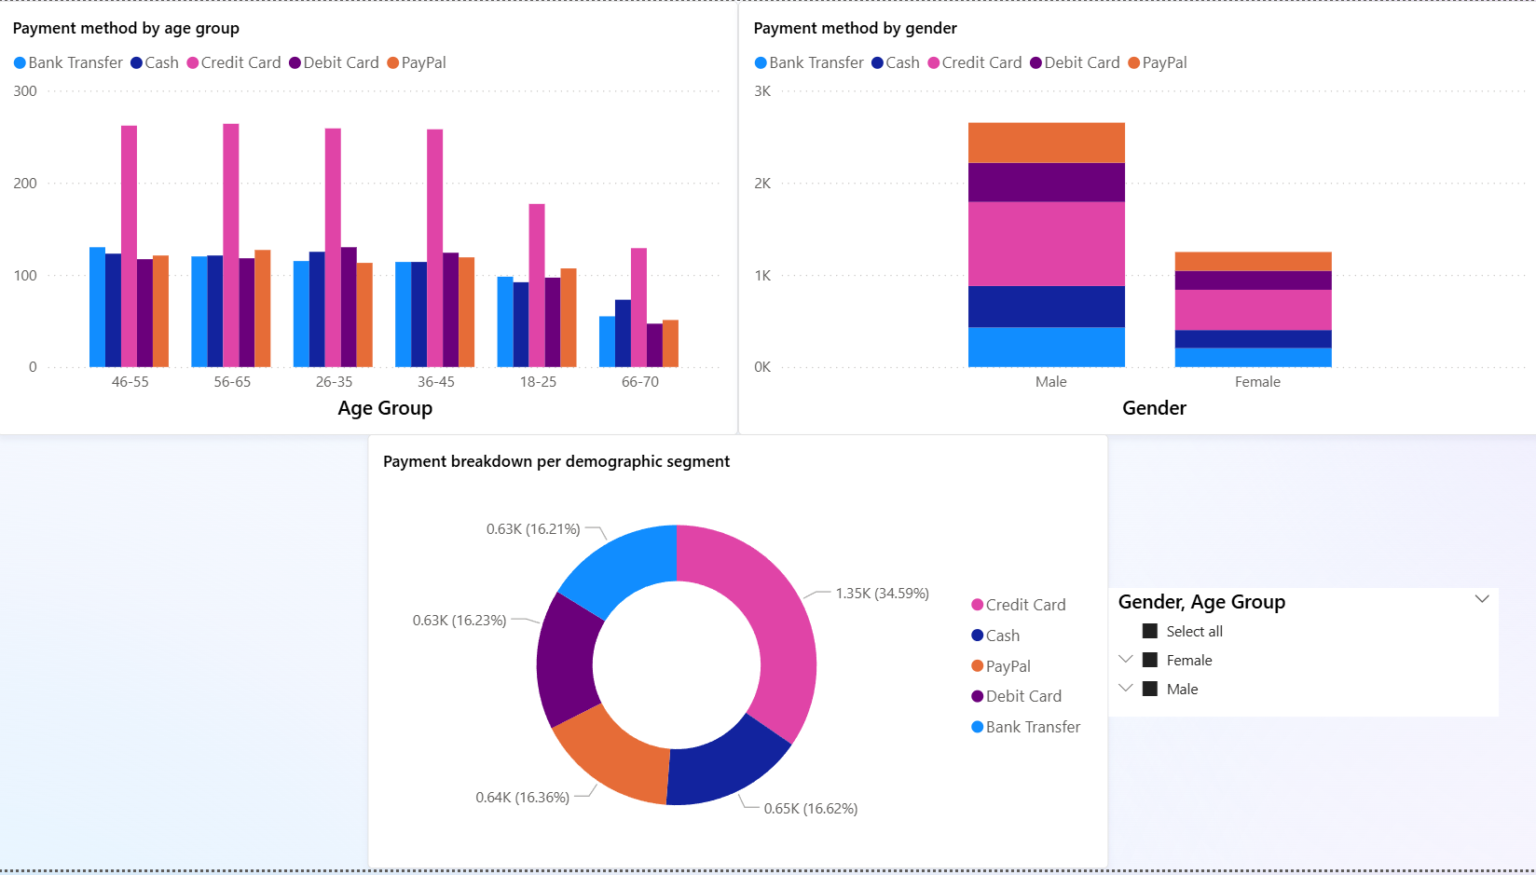
Customer Shopping Trend and Behaviour Analysis
Project Overview
Problem: A struggle retail businesses often face is trying to understand customer purchasing patterns which limits their ability to tailor marketing strategies and optimise sales. This is because without actionable insights into consumer behaviour, companies risk inefficient resource allocation and missed opportunities for customer engagement.
Requirements: A comprehensive analysis of customer shopping data to identify trends, segment customers, and derive actionable insights. The project requires preprocessing raw data, performing exploratory data analysis (EDA), applying clustering techniques for customer segmentation, and developing interactive dashboards using Power BI or Tableau to visualise findings.
Solution: The project involves cleaning and enriching the customer dataset, conducting EDA to uncover purchasing trends, and using K-means clustering to segment customers based on demographics, spending habits, and purchase frequency. Each team member will create a unique Power BI/Tableau dashboard to present insights, enabling businesses to personalise marketing strategies and improve customer retention.
Technologies: Python for data preprocessing and EDA, K-means clustering for segmentation, Power BI/Tableau for interactive dashboard development, and Excel to perform data exploration.
Product category preferences by seasons
Total revenue produced by each product category
Replace with a photo of the team at work
Team Members
Muhsinah, Eva,
Han Shen
Supervisor
Mr Wee Kin Guan
Preferred payment method by age group and gender
Notes:
NOTES
Refer to write ups in ‘Past Projects for Reference’ Booklet for Project overview write ups - Student Academic - Project (sharepoint.com)
ENGLISH – British. E.g. organisation VS organization
Font: RP approved font - Arial family only.
Header: Arial Bold
Copy text: Arial regular or Arial Bold. Use Emphasis of SOI’s orange colour in moderation.
Picture frame – Give a 4.5 or 6pt orange outline.

